Slide 1
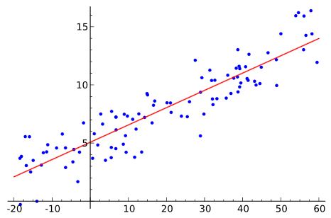
Extrapolation vs. Prediction
Extrapolation
Prediction
From model
Modeling: Creating a model that allows us to estimate values between data
Extrapolation: Using existing data to estimate values outside the range of our data

Slide 2
Model Selection
Need a method to select the “best” set of independent variables (covariates/predictors)
  Also the the best method and estimated parameter values (coefficients)
Should be a balance between fitting the data and simplicity
  R² – only considers fit to data (but linear regression is pretty simple)

Slide 3
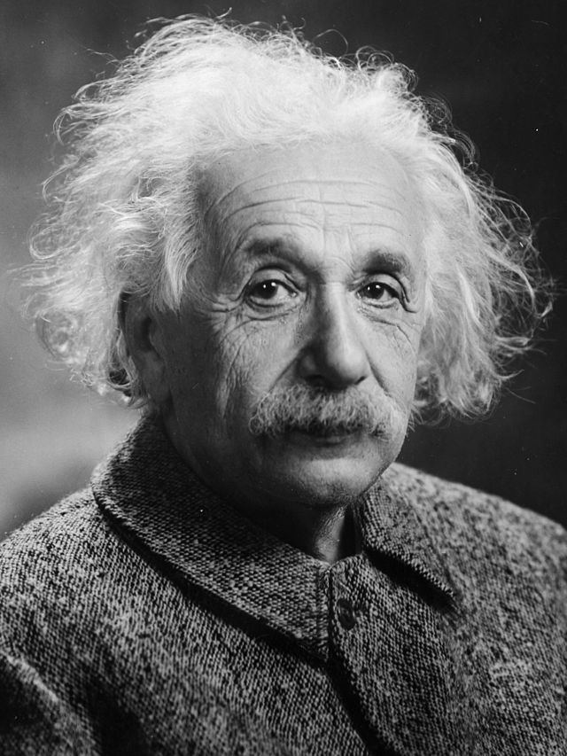
Simplicity
Everything should be made as simple as possible, but not simpler.
  Albert Einstein
Photograph by Oren Jack Turner, Princeton, licensed through Wikipedia

Slide 4
Parsimony
“…too few parameters and the model will be so unrealistic as to make prediction unreliable, but too many parameters and the model will be so specific to the particular data set so to make prediction unreliable.”
  Edwards, A. W. F. (2001). Occam’s bonus. p. 128–139; in Zellner, A., Keuzenkamp, H. A., and McAleer, M. Simplicity, inference and modelling. Cambridge University Press, Cambridge, UK.

Slide 5
Parsimony
Under fitting
model structure …included in the
residuals
Over fitting
residual variation
is included as if it were structural
Parsimony
Anderson

Slide 6
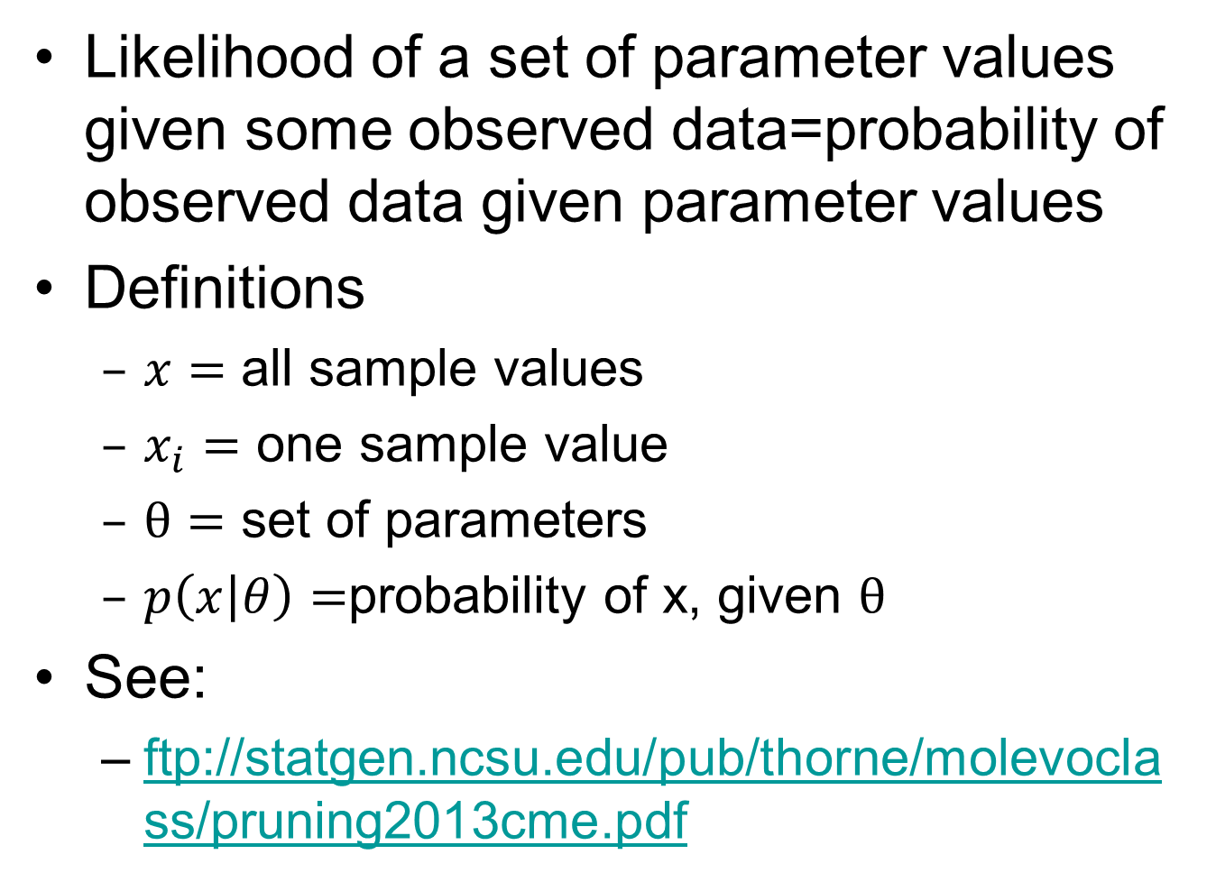
Likelihood
Likelihood of a set of parameter values given some observed data=probability of observed data given parameter values
Definitions
  $x=$ all sample values
  $x_{i}=$ one sample value
  $θ=$ set of parameters
  $p\left(x | θ\right)=$probability of x, given $θ$
See:
  ftp://statgen.ncsu.edu/pub/thorne/molevoclass/pruning2013cme.pdf

Slide 7
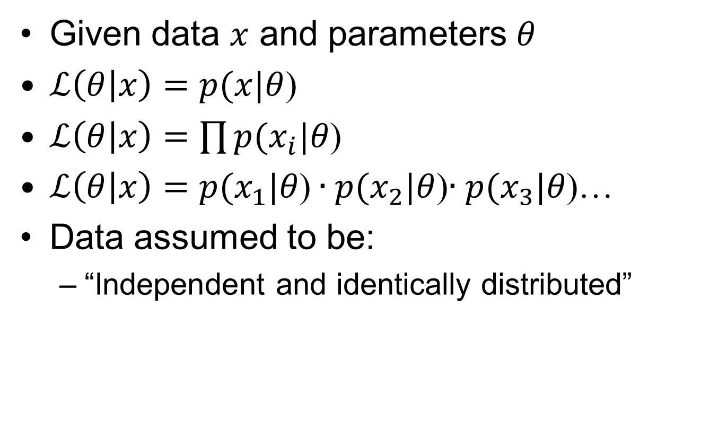
Likelihood

Slide 8
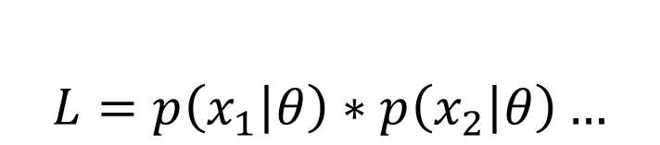
p(x) for a fair coin
$$L=p\left(x_{1} | θ\right)∗p\left(x_{2} | θ\right)…$$
0.5
Heads
Tails
What happens as we flip a “fair” coin?

Slide 9
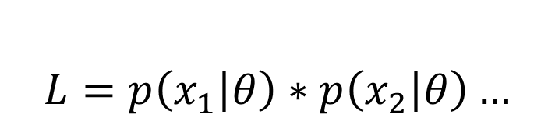
p(x) for an unfair coin
$$L=p\left(x_{1} | θ\right)∗p\left(x_{2} | θ\right)…$$
0.8
Heads
0.2
Tails
What happens as we flip a “fair” coin?

Slide 10
p(x) for a coin with two heads
$$L=p\left(x_{1} | θ\right)∗p\left(x_{2} | θ\right)…$$
1.0
Heads
0.0
Tails
What happens as we flip a “fair” coin?

Slide 11
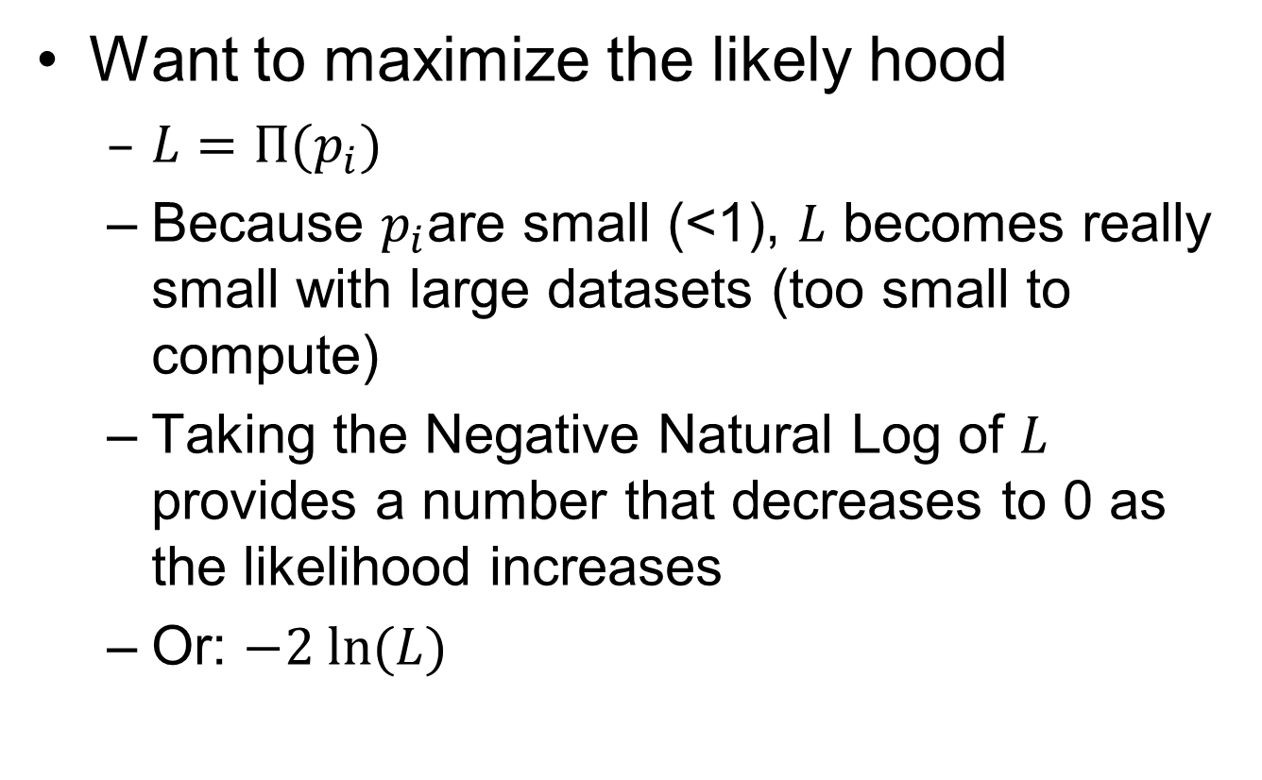
Maximum Likelihood
Want to maximize the likely hood
  $L=Π(p_{i})$
  Because $p_{i}$are small (<1), $L$ becomes really small with large datasets (too small to compute)
  Taking the Negative Natural Log of $L$ provides a number that decreases to 0 as the likelihood increases
  Or: $−2 ln⁡(L)$

Slide 12
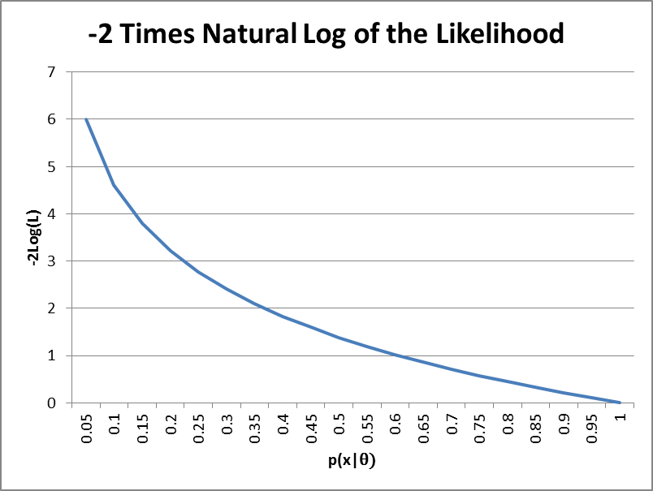
-2 Times Log Likelihood

Slide 13

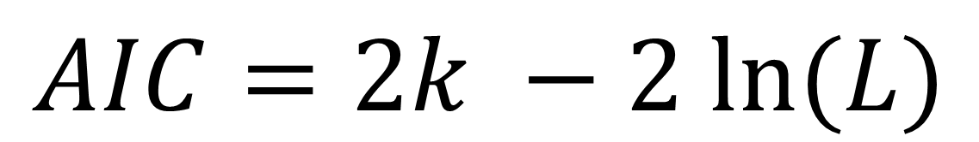
Akaike Information Criterion
AIC
K = number of estimated parameters in the model
L = Maximized likelihood function for the estimated model
$$AIC=2k −2 ln⁡(L)$$

Slide 14
AIC
Only a relative meaning
Smaller is “better”
Balance between complexity:
  Over fitting or modeling the errors
  Too many parameters
And bias
  Under fitting or the model is missing part of the phenomenon we are trying to model
  Too few parameters

Slide 15
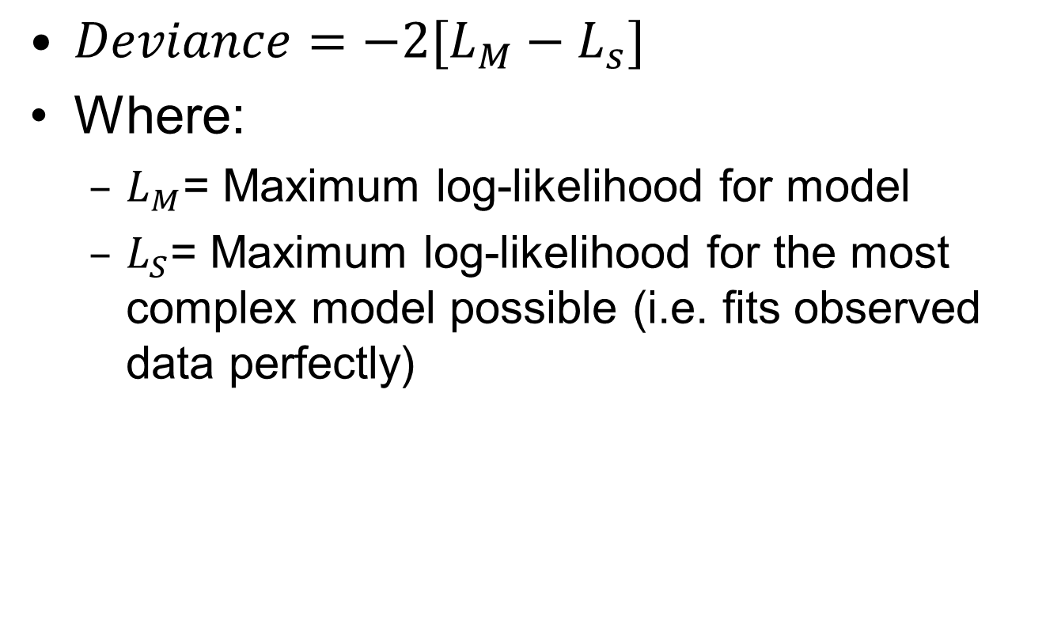
Deviance
$Deviance=−2[L_{M}−L_{s}]$
Where:
  $L_{M}$= Maximum log-likelihood for model
  $L_{S}$= Maximum log-likelihood for the most complex model possible (i.e. fits observed data perfectly)

Slide 16

Degrees of Freedom
$N=$number of observations
$p=$number of parameters
Degrees of freedom = $N −p$

Slide 17
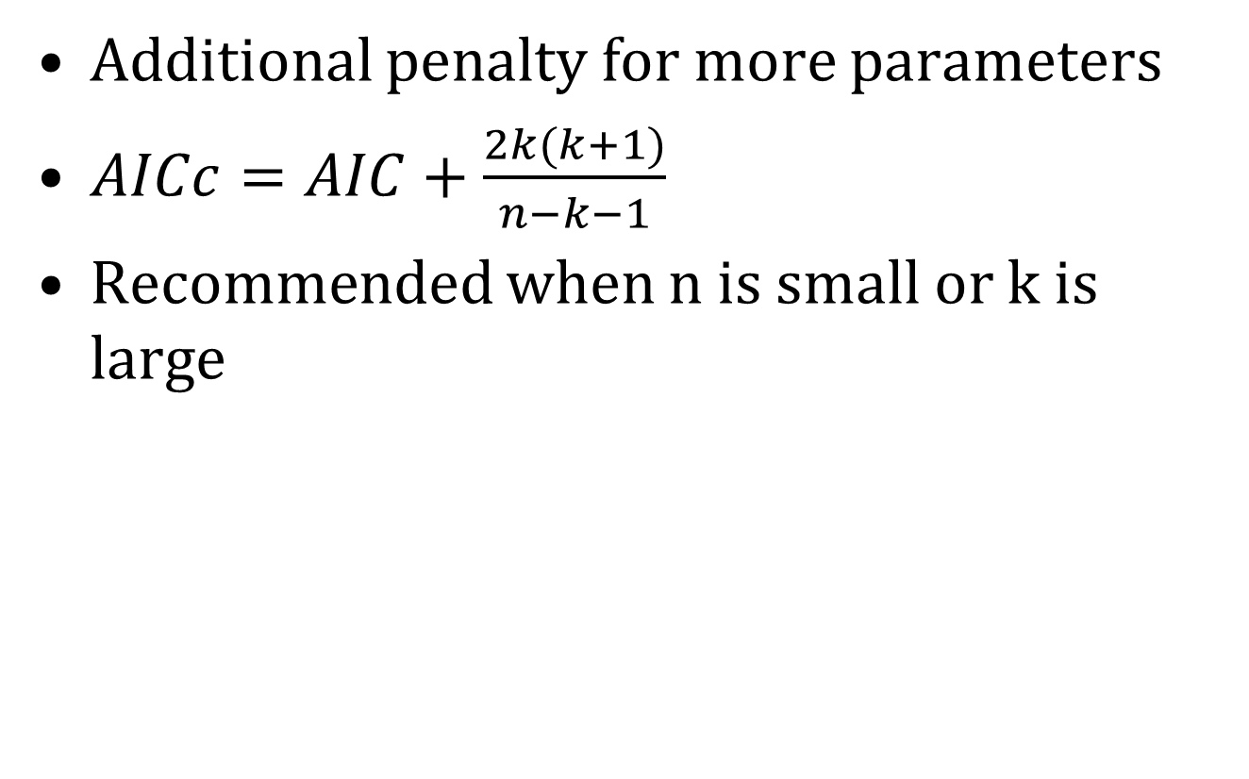
AICc
Additional penalty for more parameters
$AICc=AIC+\frac{2k(k+1)}{n−k−1}$
Recommended when n is small or k is large

Slide 18
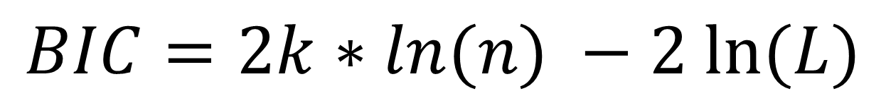
BIC
Bayesian Information Criterion
Adds n (number of samples)
$$BIC=2k∗ln(n) −2 ln⁡(L)$$

Slide 19
Extra slides

Slide 20
Does likelihood from p(x) work?
If the likelihood is the probability of the data given the parameters,
and a response function provides the probability of a piece of data (i.e. probability that this is suitable habitat)
We can use the probability that a specific occurrence is suitable as the p(x|Parameters)
Thus the likelihood of a habitat model (while disregarding bias)
Can be computed by L(ParameterValues|Data)=p(Data1|ParameterValues)*p(Data2|ParameterValues)...
Does not work, the highest likelihood will be to have a model with 1.0 everywhere, have to divide the model by it’s area so the area under the model = 1.0
Remember: This only works when comparing the same dataset!

Slide 21
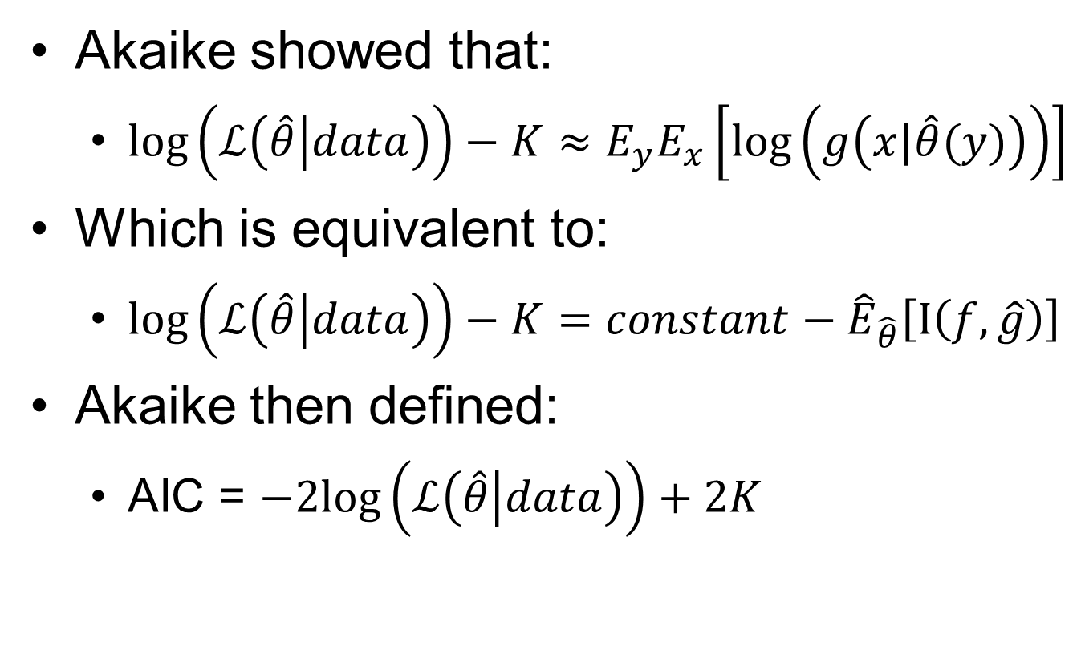
Akaike…
Akaike showed that:
  ${\log\left(ℒ\left(\hat{θ} | data\right)\right)−K≈E}_{y}E_{x}\left[\log\left(g\left(x|\hat{θ}(y)\right)\right)\right]$
Which is equivalent to:
  $\log\left(ℒ\left(\hat{θ} | data\right)\right)−K=constant−{\hat{E}}_{\hat{θ}}\left[I\left(f,\hat{g}\right)\right]$
Akaike then defined:
  AIC = $−2log\left(ℒ\left(\hat{θ} | data\right)\right)+2K$

Slide 22
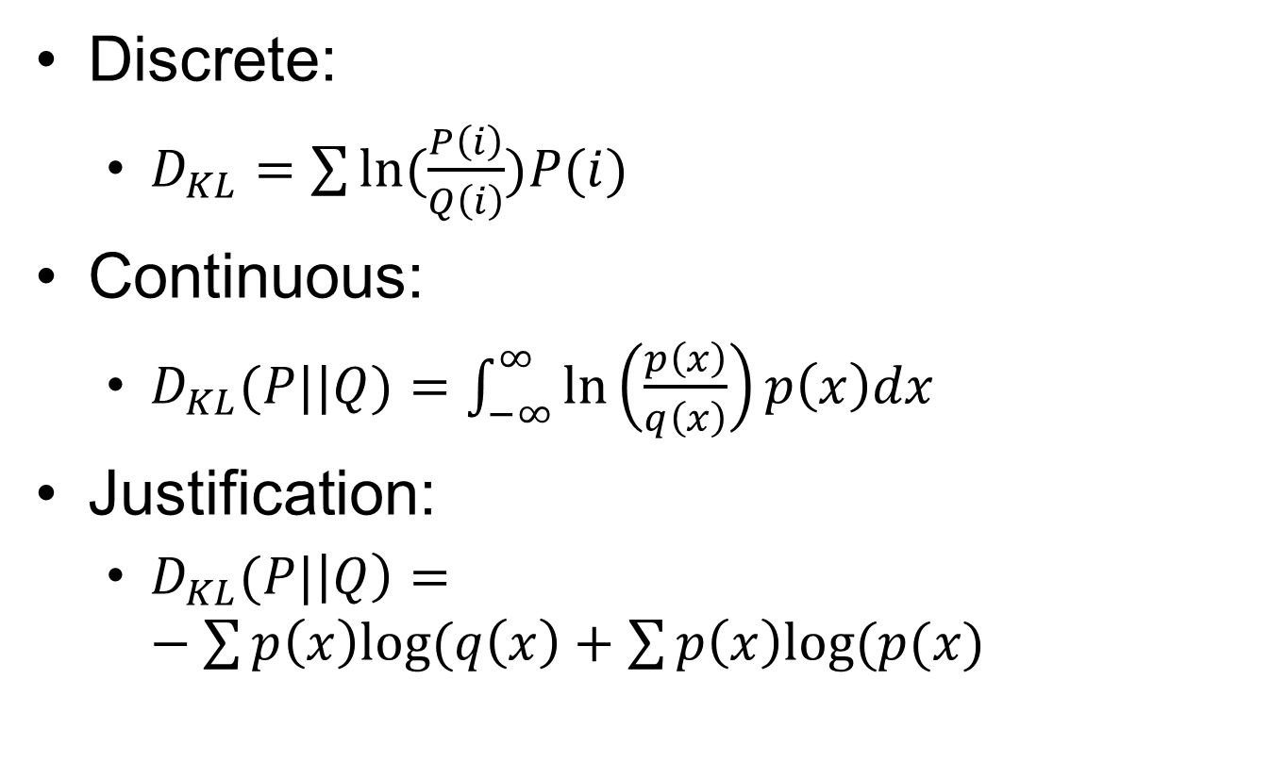
Discrete:
  $D_{KL}=\sum{ln⁡(\frac{P\left(i\right)}{Q\left(i\right)})P(i)}$
Continuous:
  $D_{KL}(P||Q)=\int_{−∞}^{∞}{\ln\left(\frac{p\left(x\right)}{q\left(x\right)}\right)p\left(x\right)dx}$
Justification:
  $D_{KL}(P|\left|Q\right)=−\sum{p\left(x\right)log⁡(q\left(x\right)+\sum{p\left(x\right)log⁡(p(x)}}$

Slide 23
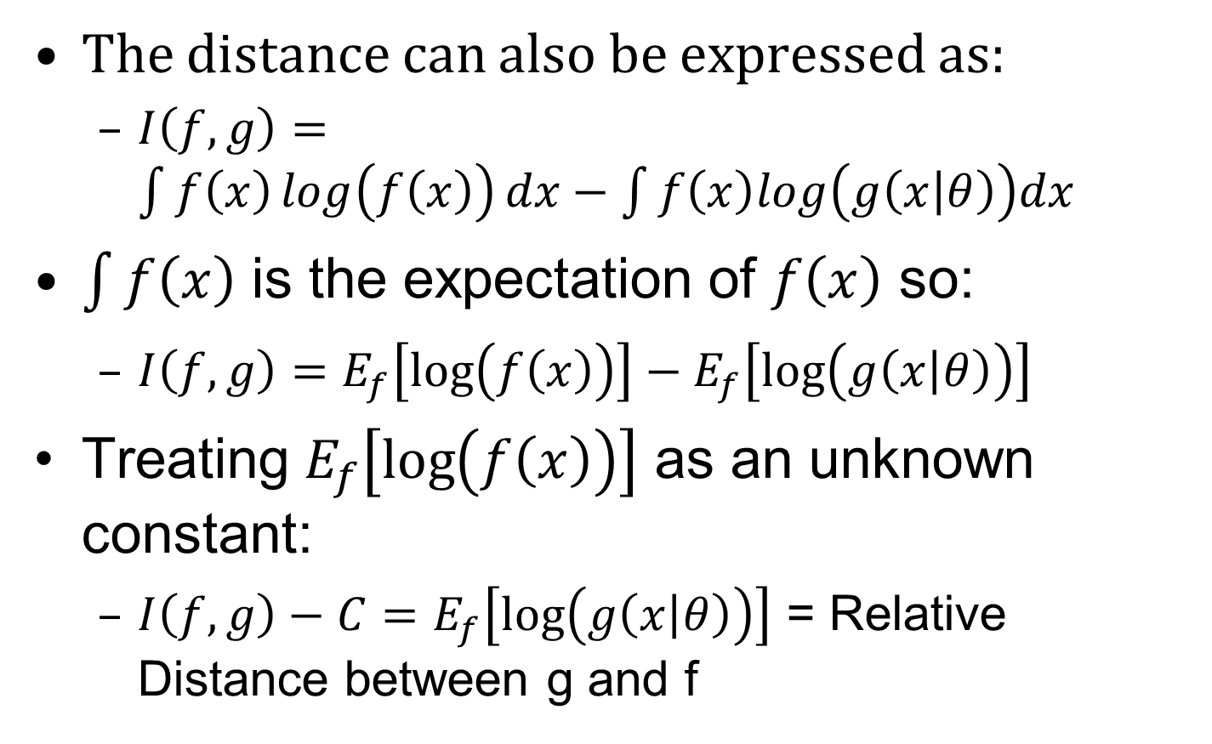
The distance can also be expressed as:
  $I\left(f,g\right)=\int{f\left(x\right)\log\left(f\left(x\right)\right)dx−\int{f\left(x\right)log\left(g\left(x | θ\right)\right)dx}}$
$\int{f\left(x\right)}$ is the expectation of $f\left(x\right)$ so:
  $I\left(f,g\right)=E_{f}\left[\log\left(f\left(x\right)\right)\right]−E_{f}\left[\log\left(g\left(x | θ\right)\right)\right]$
Treating $E_{f}\left[\log\left(f\left(x\right)\right)\right]$ as an unknown constant:
  $I\left(f,g\right)−C=E_{f}\left[\log\left(g\left(x | θ\right)\right)\right]$ = Relative Distance between g and f

